Slide 1
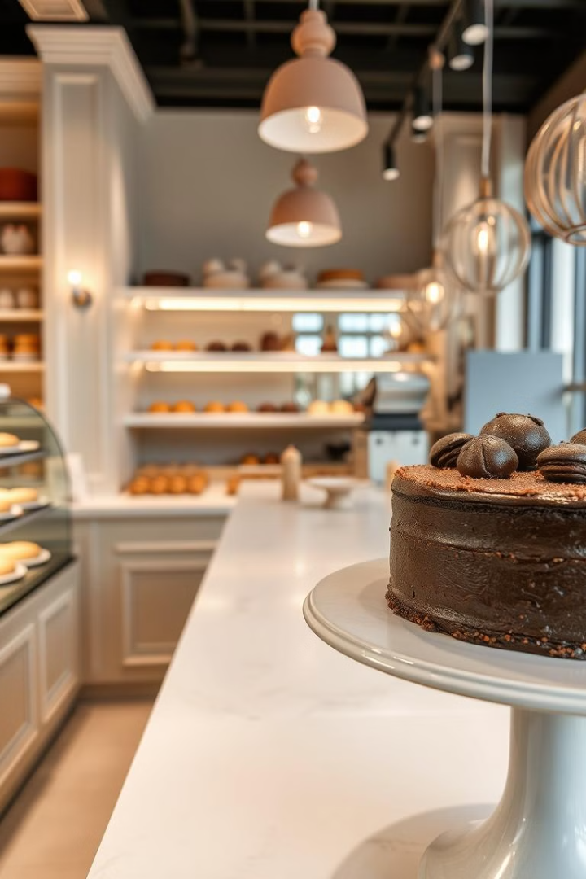

Blabn E-commerce Project Overview
Blabn is a modern e-commerce web application designed for a dessert restaurant. This project leverages the power of ASP.NET Core MVC to manage a wide range of dessert products and online orders.
by Amr Abdelaziz

Slide 2
Managing Desserts and Orders with ASP.NET Core MVC
Front-End Technologies
Back-End Technologies
HTML
ASP.NET Core MVC
CSS
C#
JavaScript
Entity Framework
SQL Server

Slide 3

[Sep 2024--October 2024]
1
Project Kick-Off
Initial project planning and requirements gathering.
2
Development & Design
Front-end and back-end development, user interface design, and database setup.
3
Testing & Deployment
Thorough testing, bug fixing, and deployment to a live server.

Slide 4
The system allows customers to browse products, add items to their cart, and place orders.
Product Browsing
Cart Management
Order Placement
Customers can browse an extensive selection of delicious desserts, categorized by type and flavor, making it easy to find their favorites.
Users can easily add items to their cart, modify quantities, and review their order summary before proceeding to checkout.
The checkout process is streamlined and secure, allowing customers to provide delivery details.

Slide 5
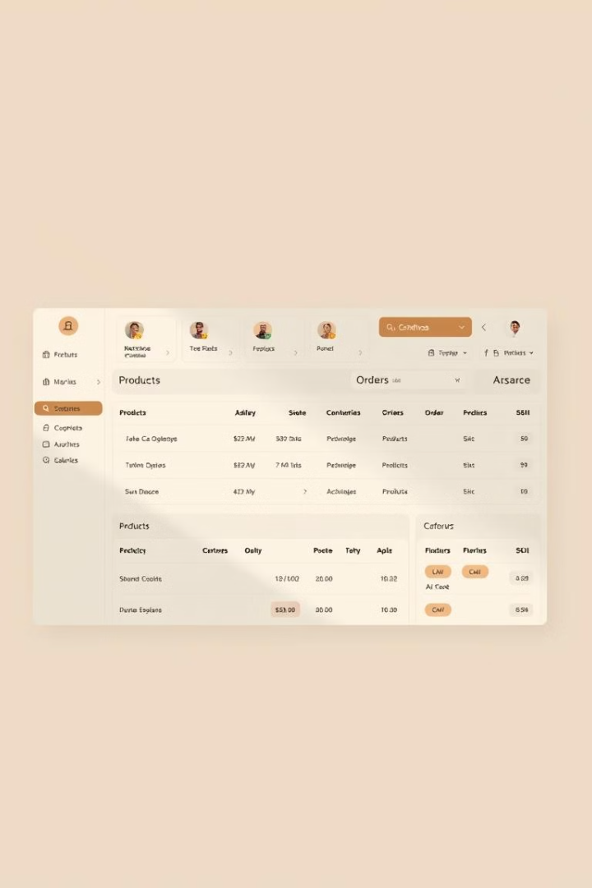
Admins can manage product listings, categories, and order information through an admin dashboard.
Product Listings
Categories
Admins can add, edit, and remove product listings, including details like descriptions, prices, and images.
Admins can create, modify, and delete product categories to organize the menu and provide a clear browsing experience for customers.
Order Information
Admins can access and manage all order details, including customer information, order status, and payment information.

Slide 6



Team Member
Amr Abdel Aziz
Mina Magdi
Lead Developer, responsible for backend architecture and development.
Front-End Developer, designing and implementing user interfaces.

Slide 7



Conclusion
Successful Launch
1
The Blabn e-commerce website was successfully launched, providing a user-friendly platform for online dessert ordering.
Positive User Feedback
2
Early user feedback has been overwhelmingly positive, with praise for the website's design, functionality, and ease of use.
Increased Sales
3
The website has driven significant sales growth for the dessert restaurant, exceeding initial projections.

